Slide 1
Mobile Scanner
ENEE631 : Digital Image and Video Processing
By
Lakshman Kumar
M.Eng ( Robotics)
Maryland Robotics Center
Notes:
Hello everyone, I am Lakshman Kumar

Slide 2
Introduction
With increasing prevalence of Cell Phones, traditional devices, that have been used for various tasks , are being replaced by it.
One such device is the document scanner.
Several popular apps like CamScanner , Evernote etc. are being used to scan documents nowadays.
This project attempts to reverse engineer the methodology used by such apps to extract and register documents.

Slide 3
Problem Statement
Extraction of a document from a mobile phone’s image.
Registration of a reference blank page
Extraction of content from the filled version of the reference document.

Slide 4
Assumptions Made
The reference document
is captured in a well lit and contrasting environment
is rectangular and convex
has clearly visible edges and corners in the image
occupies the most area in the captured image
The filled document
has sufficient features

Slide 5
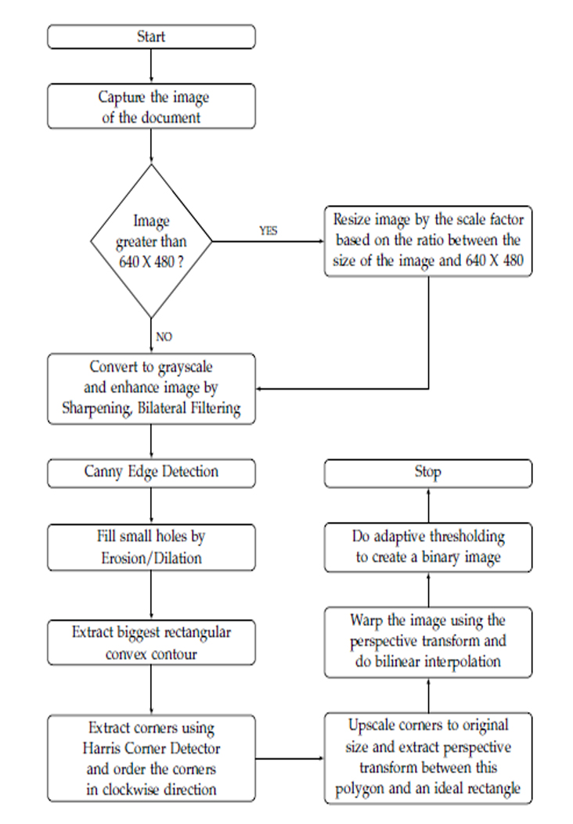
Document Extraction Methodology

Slide 6
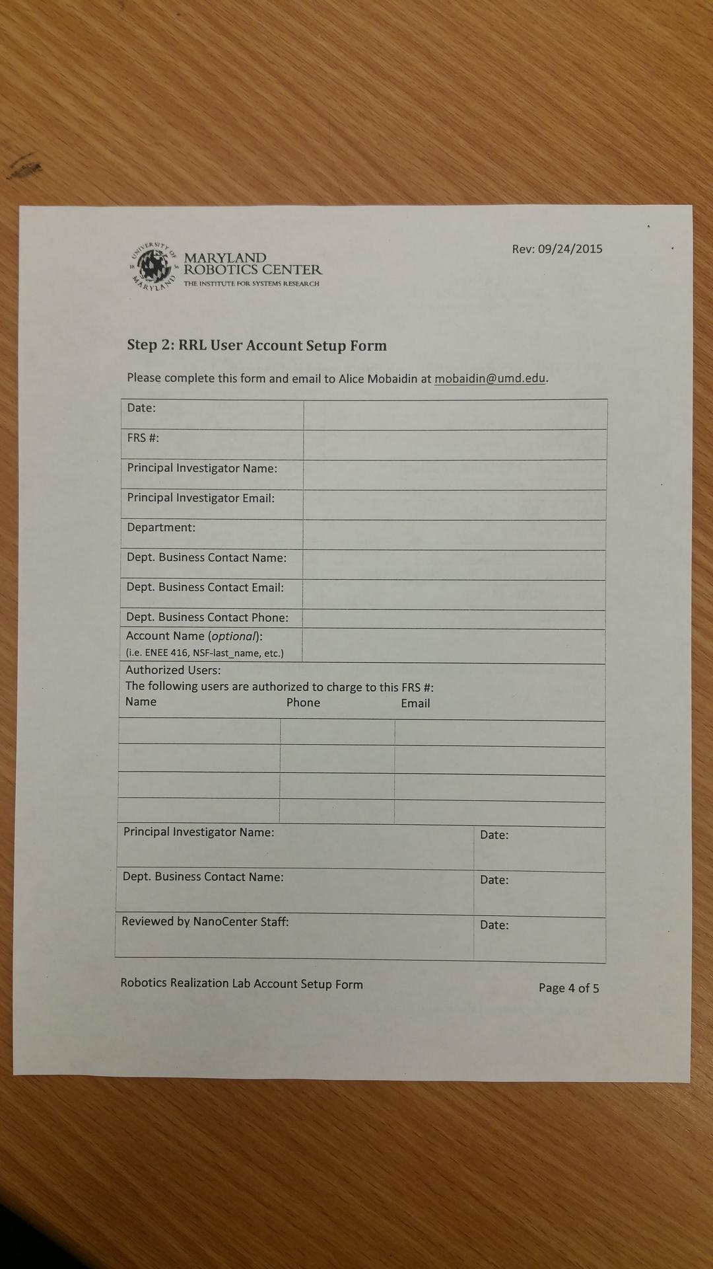
Input Image

Slide 7
Image Enhancement
To make the image suitable for further processing
Conversion to grayscale
Sharpening
Bilateral Filtering

Slide 8
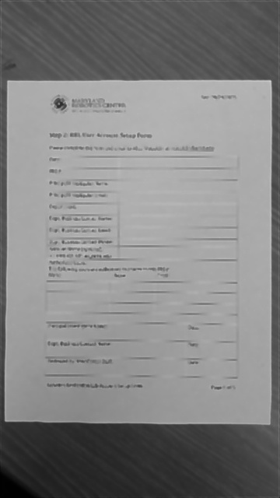
Image Enhancement

Slide 9
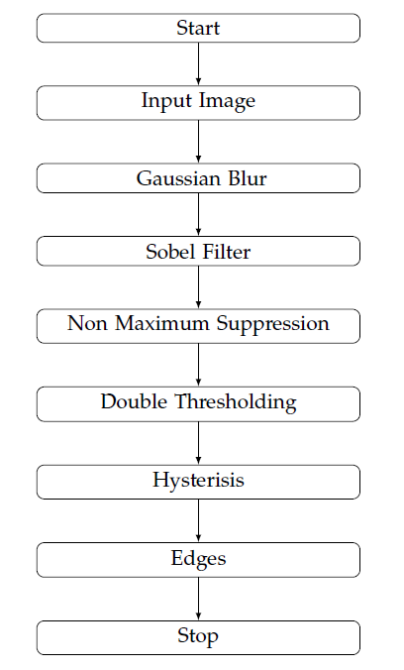
Canny Edge Detection
To extract edges required for shape detection

Slide 10
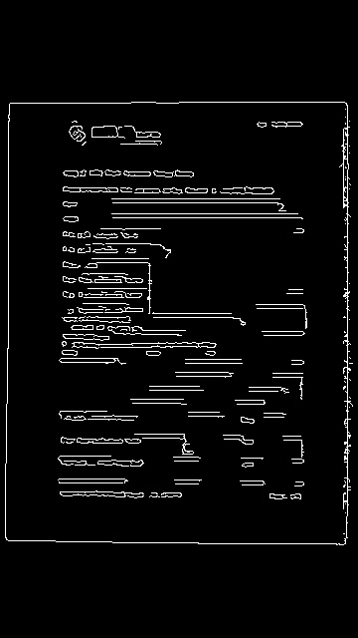
Canny Edge Detection

Slide 11
Morphological Operations
To fill in the holes or discontinuities in the extracted edges
Morphological closing with dilation followed by erosion
To remove noise in the resulting edges
Morphological opening with erosion followed by dilation

Slide 12
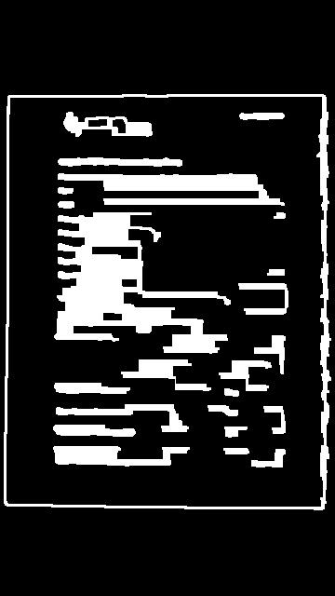
Morphological Operations

Slide 13
Contour Detection
To find the largest rectangular and convex polygon in the image
Used OpenCV’s “FindContour” function
API implements Suzuki et al’s “Topological Structured Analysis of Digitized Binary Images by Border Following “
Traverse through the hierarchy of contours to find a convex polygon with 4 vertices and largest area

Slide 14
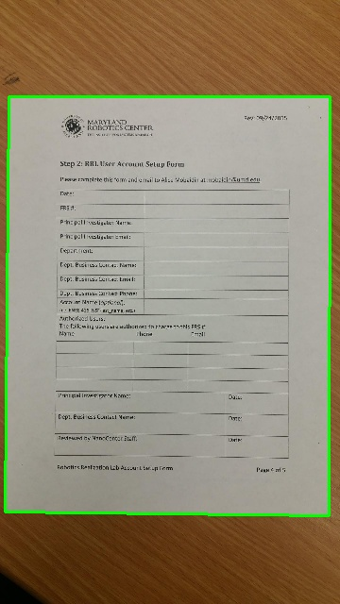
Contour Detection

Slide 15
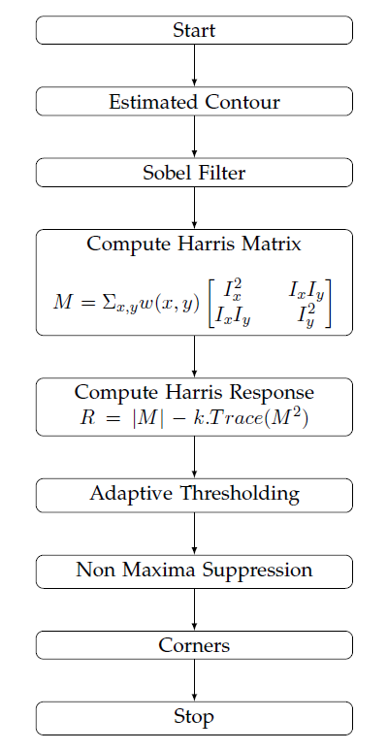
Harris Corner Detection
To extract four corners of the detected contour

Slide 16
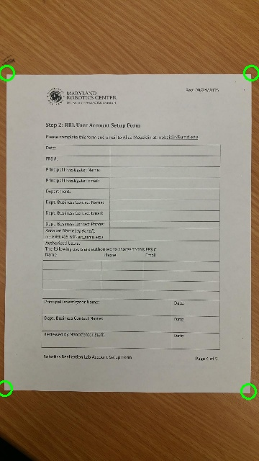
Harris Corner Detection

Slide 17
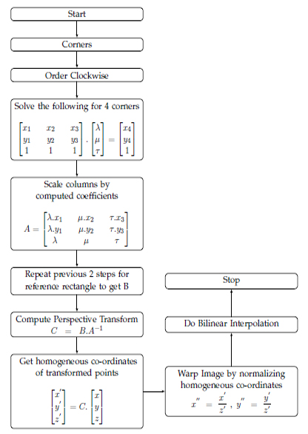
Perspective Transform and Warping
To warp the document to fill the image

Slide 18
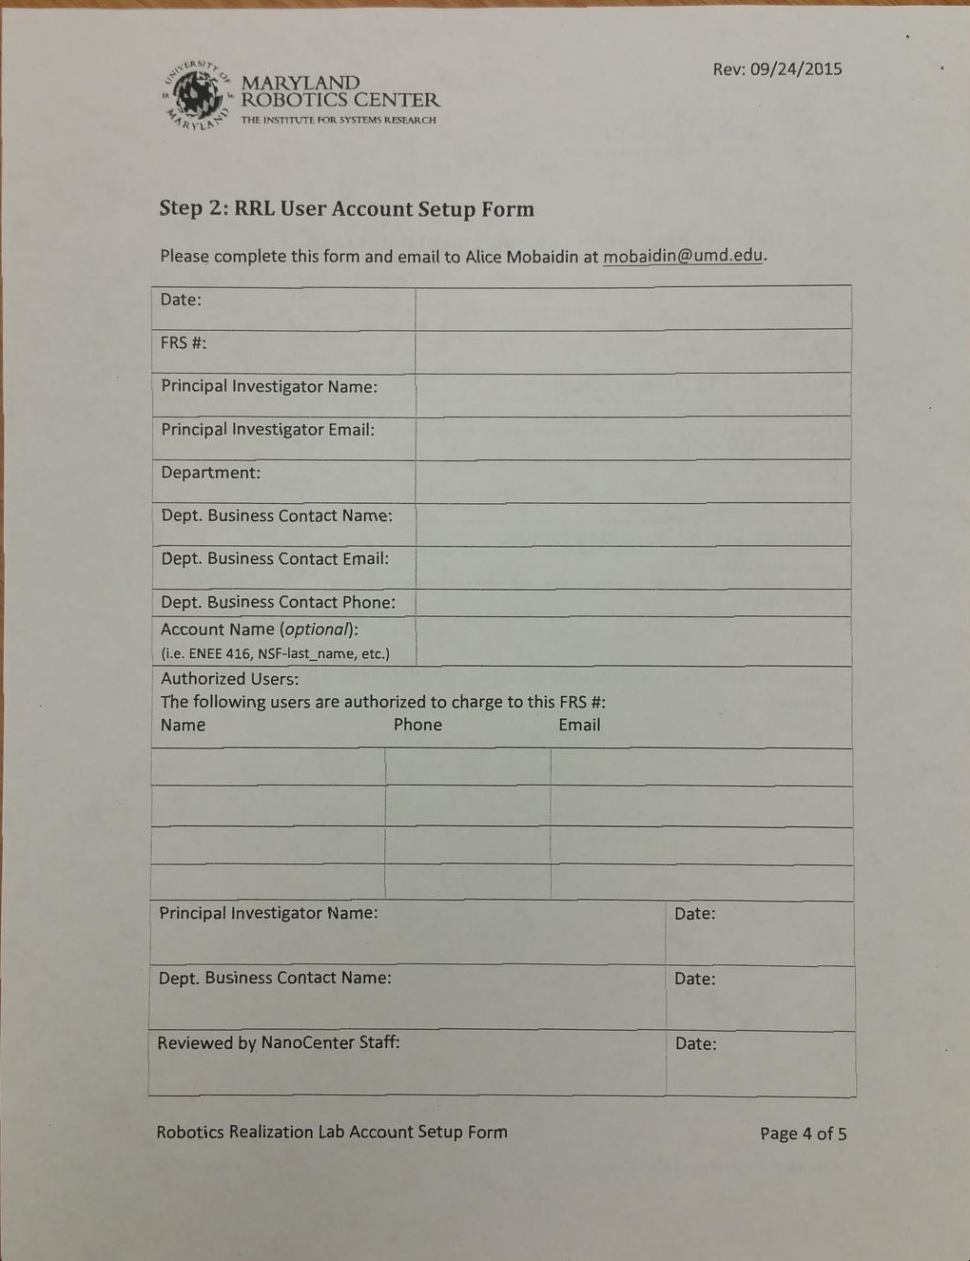
Perspective Transform and Warping

Slide 19
Adaptive Thresholding
To convert rgb image to binary image
Adaptive thresholding was done using the Gaussian Minus C method
Global thresholding gives bad results as the threshold is constant throughout the image
Adaptive thresholding makes the threshold dynamic in nature and hence gives pretty good results

Slide 20
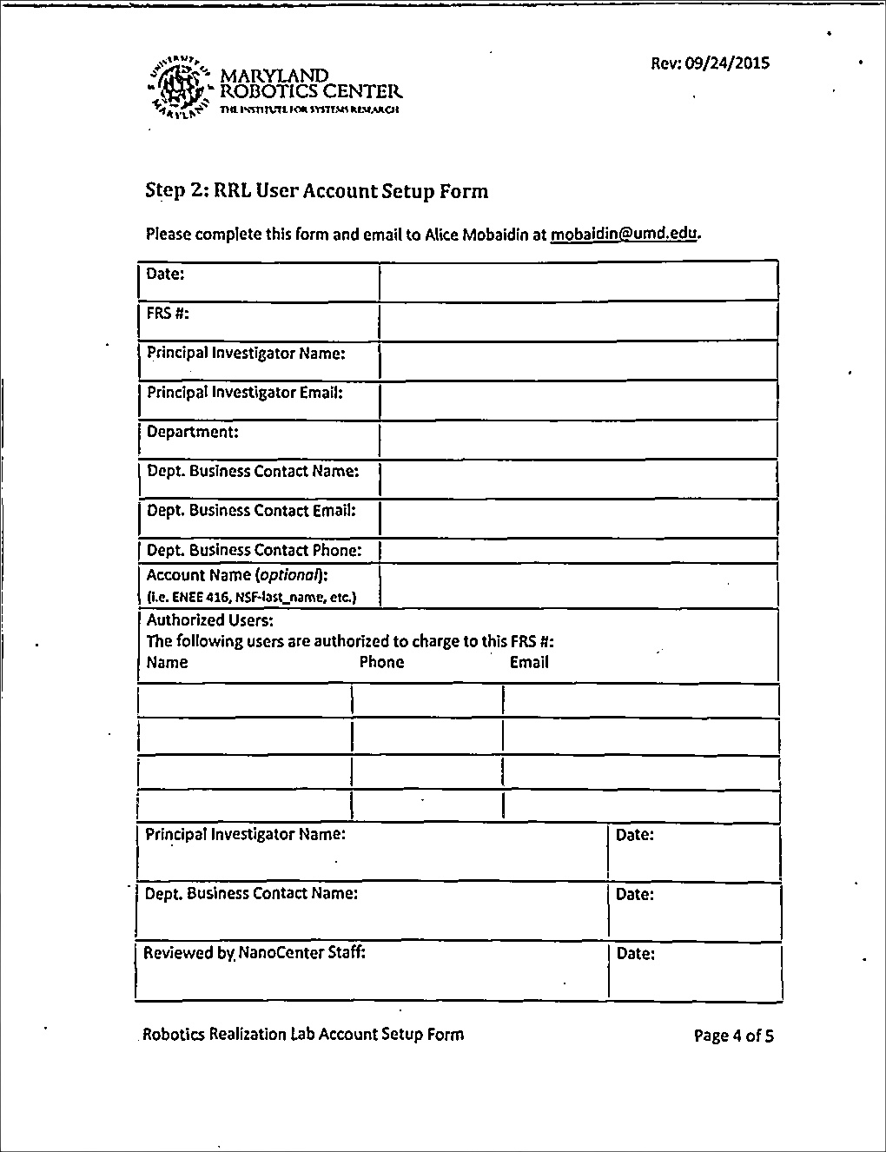
Adaptive Thresholding

Slide 21
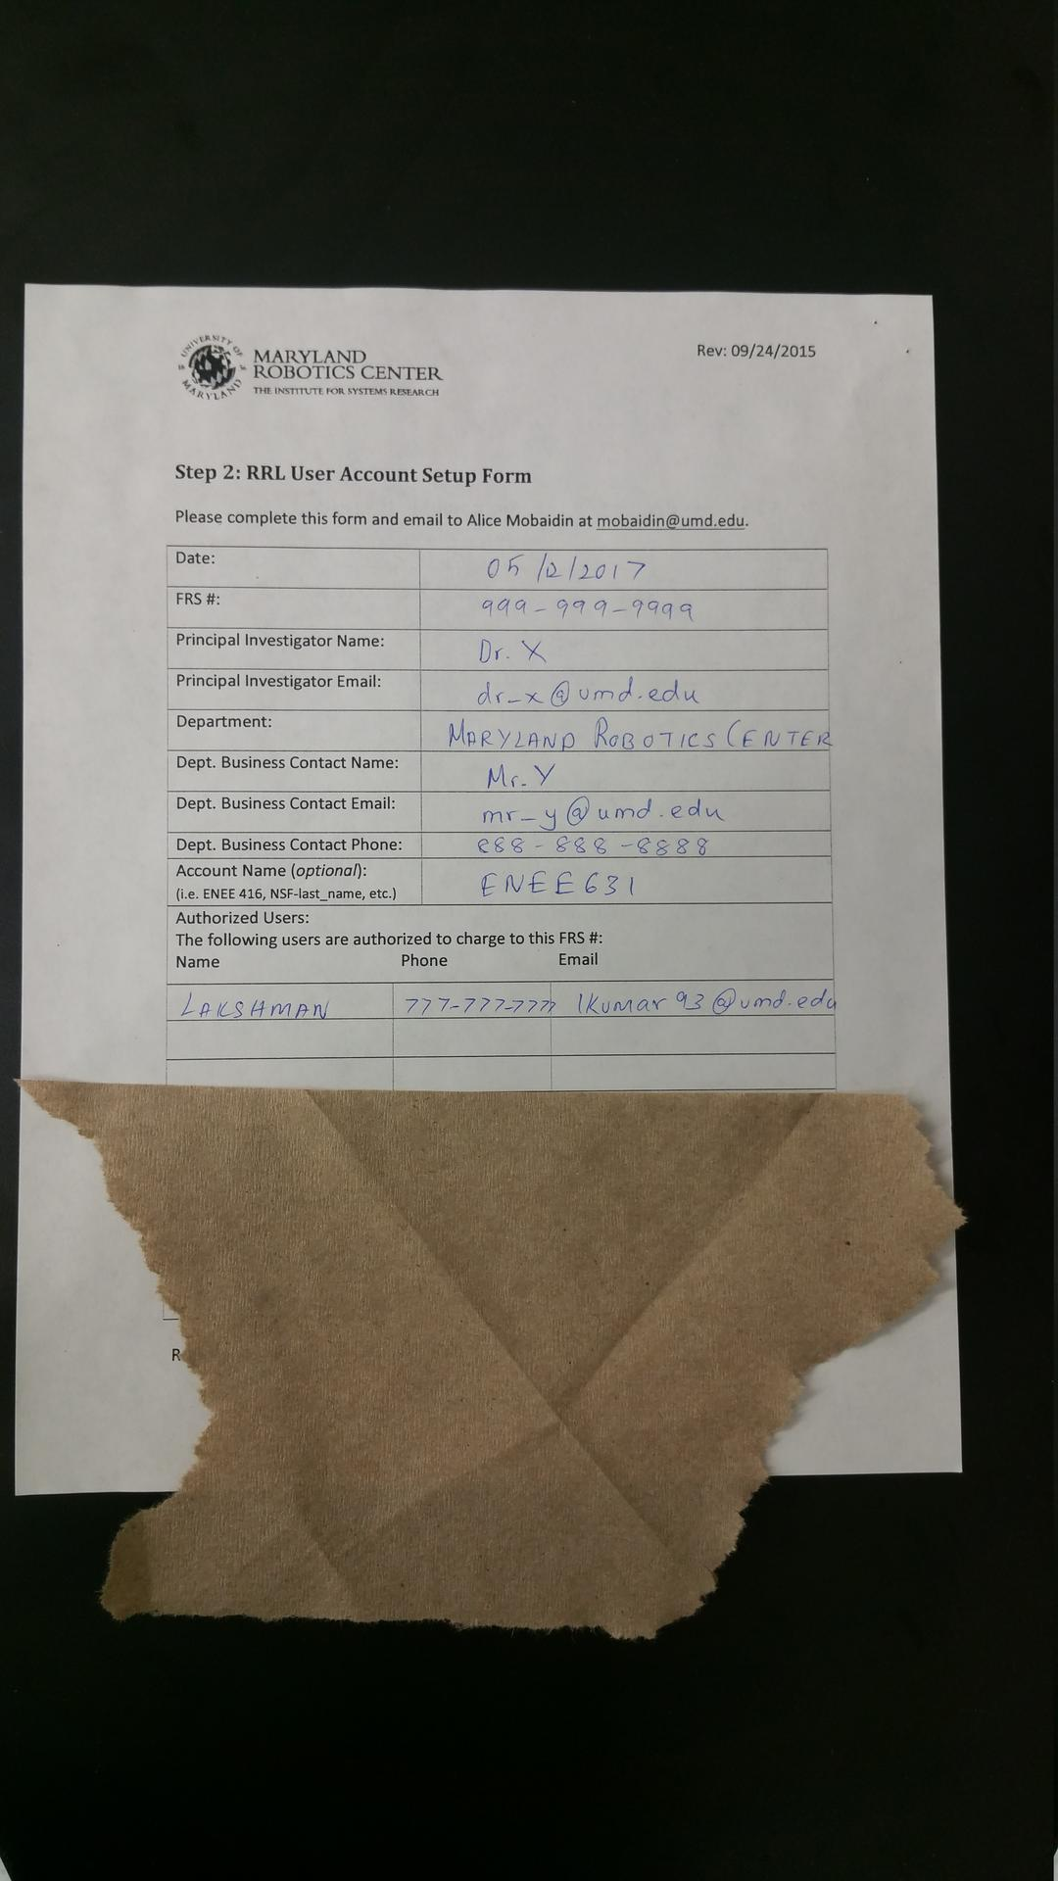
Filled Document

Slide 22
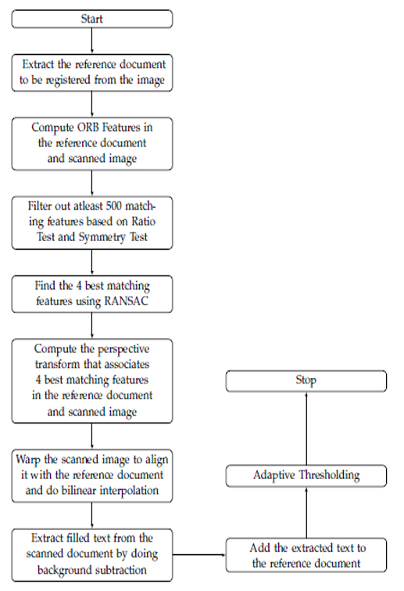
Image Registration
To extract content from the image of the filled document

Slide 23
Image Alignment
To align the filled document with the reference document
Compute features in both the reference document and filled document
OpenCV’s feature detection and description API was used
ORB (Oriented FAST and Rotated BRIEF) features were used
ORB is computationally less intensive than SIFT/SURF but gives similar performance
The API finds the corresponding features using the k- Nearest Neighbor technique with hamming distance as the metric
These features are then filtered by ratio test and symmetry test
At-least 500 corresponding features that satisfies both these tests are extracted
Then the best four features are obtained by doing RANSAC with 50,000 iterations
The perspective transform between these four features in the reference document and the filled document is extracted
The filled document is warped to align with the reference document

Slide 24
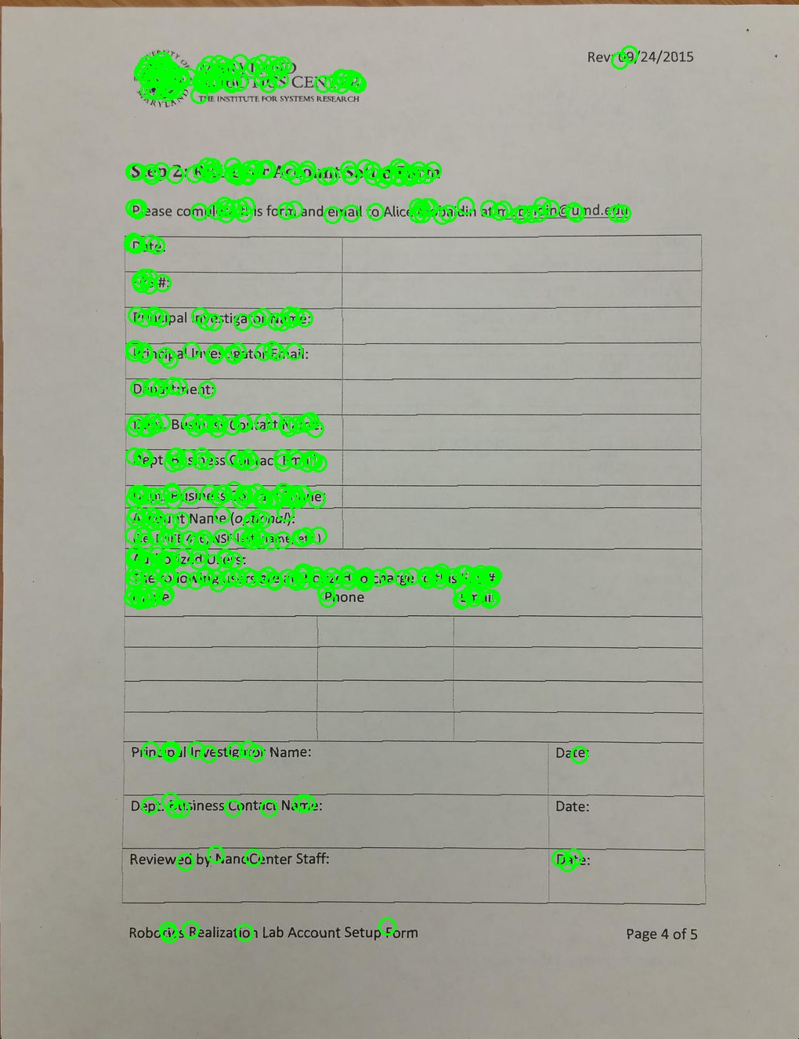
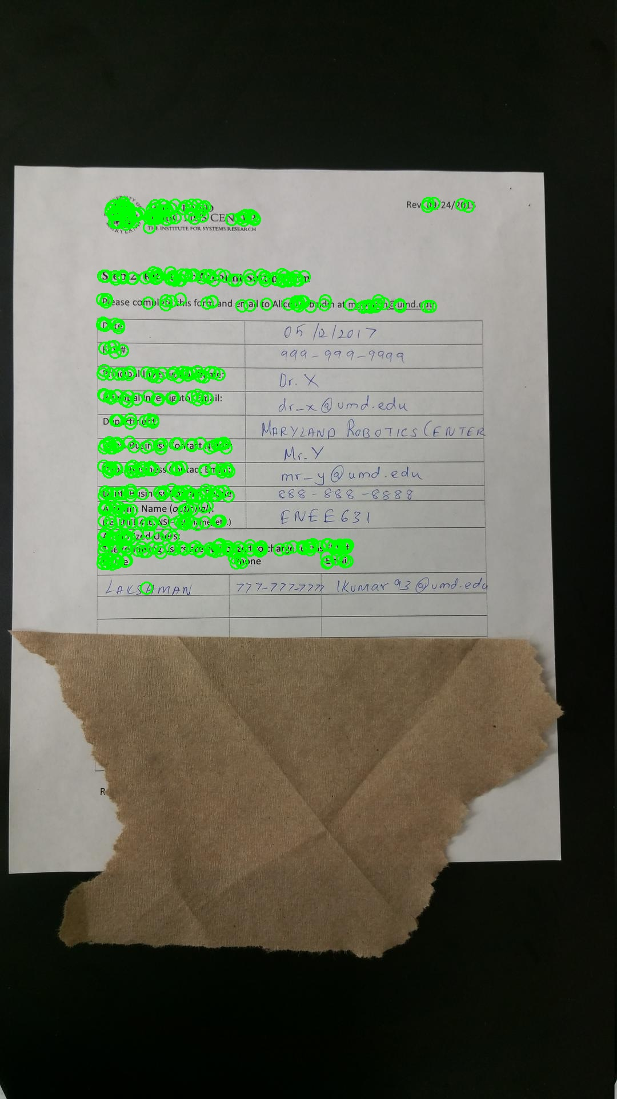
Image Alignment
500 corresponding ORB features

Slide 25
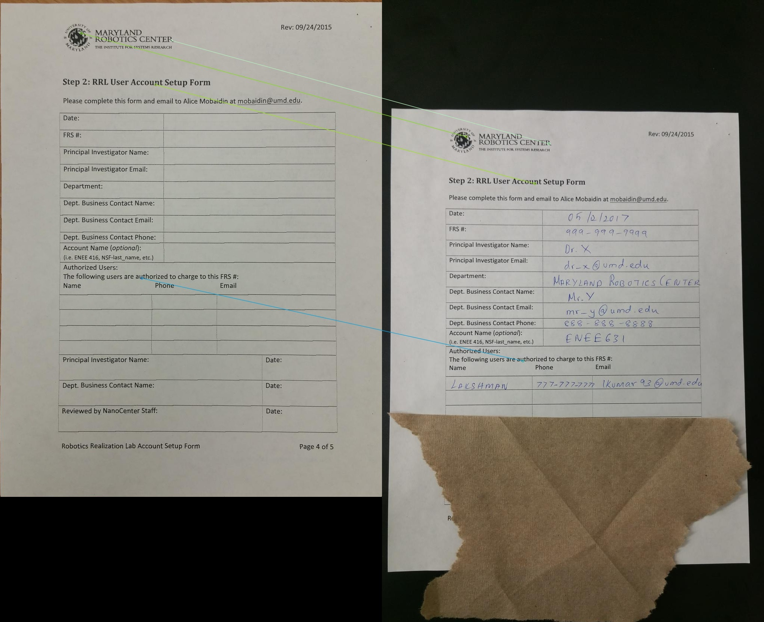
Image Alignment
Four best corresponding ORB features

Slide 26
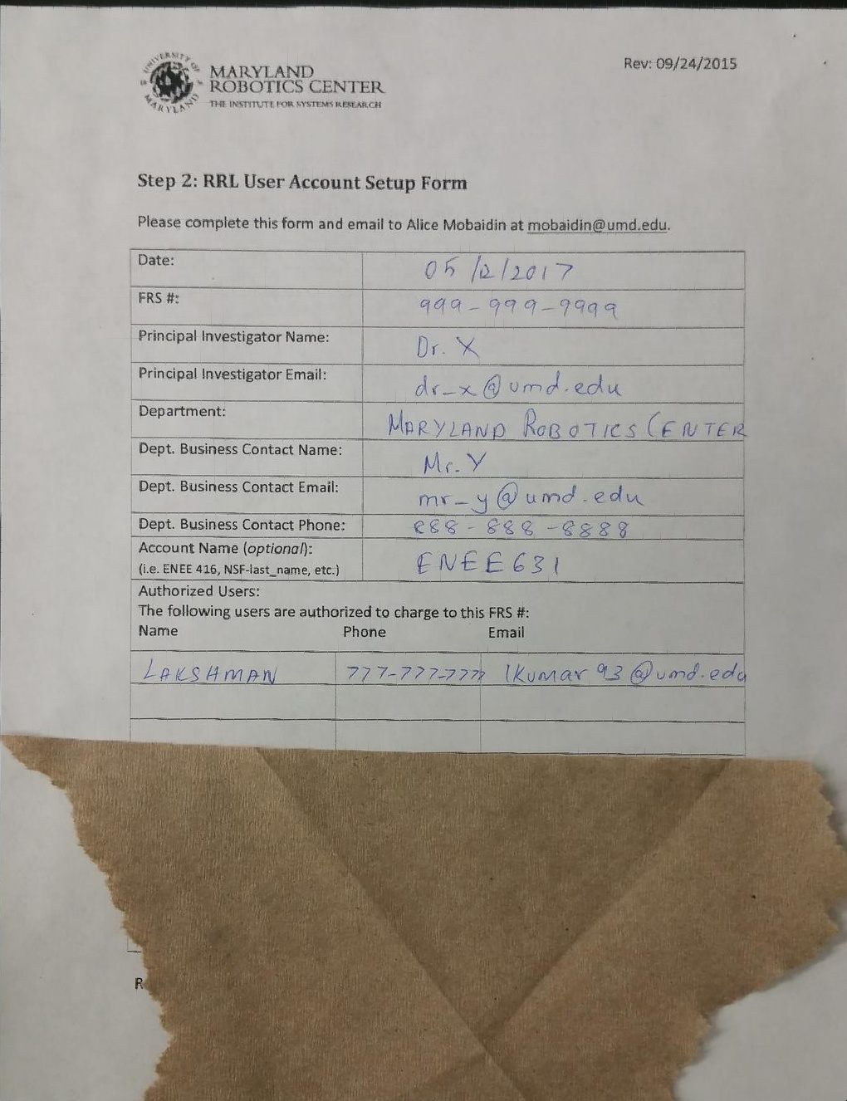
Image Alignment
Warp the filled document and do bilinear interpolation

Slide 27
Background Subtraction
To extract content from the filled document
Both the reference and scanned document are converted into binary images by adaptively thresholding
Using combinational logic based on the values of the pixels in thresholded images, the additional content in the filled document is extracted
The extracted content is then filtered a bit by dilation and median filtering
However there might be some additional residue due to imperfect thresholding , minute differences in alignment caused by either Bilinear Interpolation or lesser number of iterations in RANSAC.

Slide 28
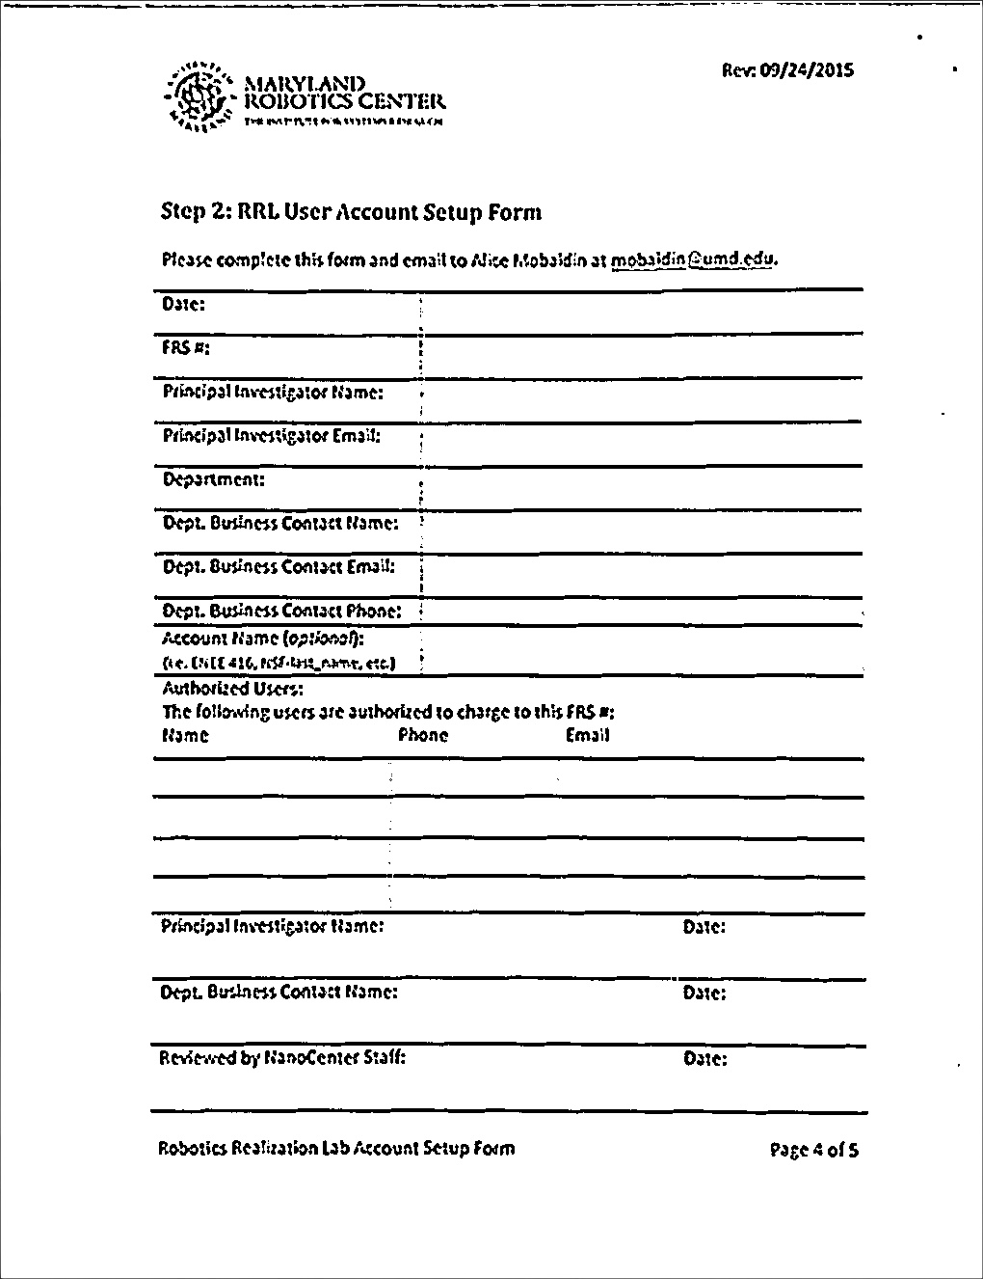
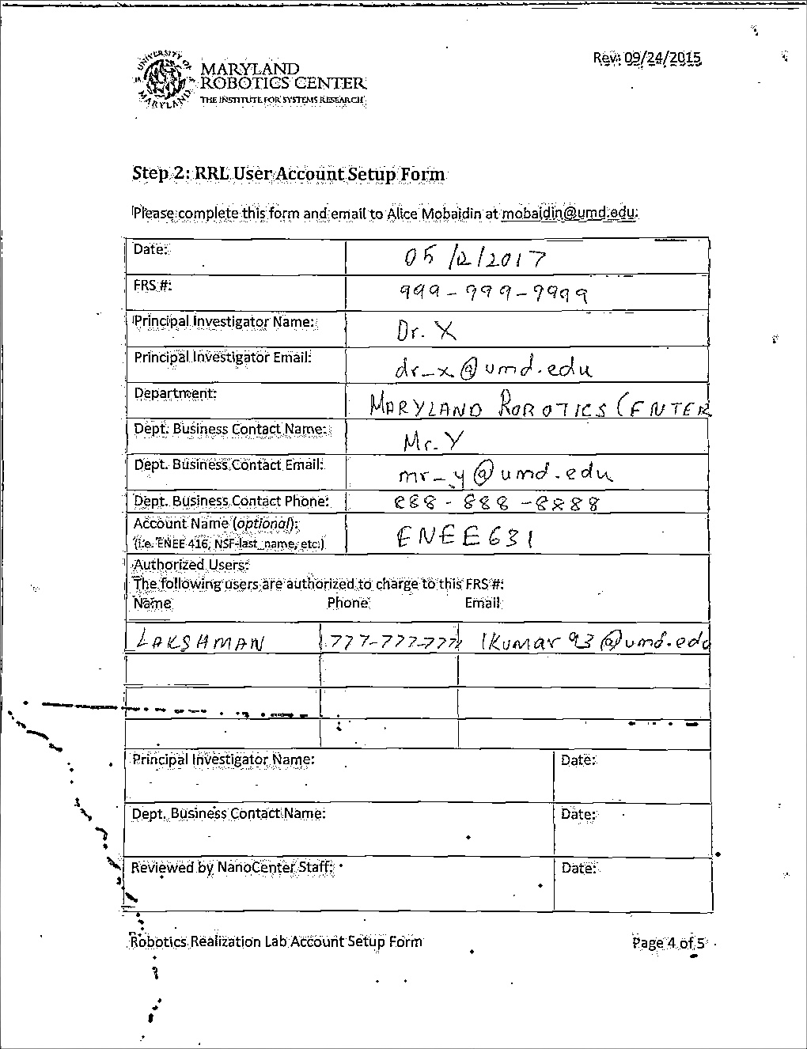
Background Subtraction
Thresholded Images

Slide 29
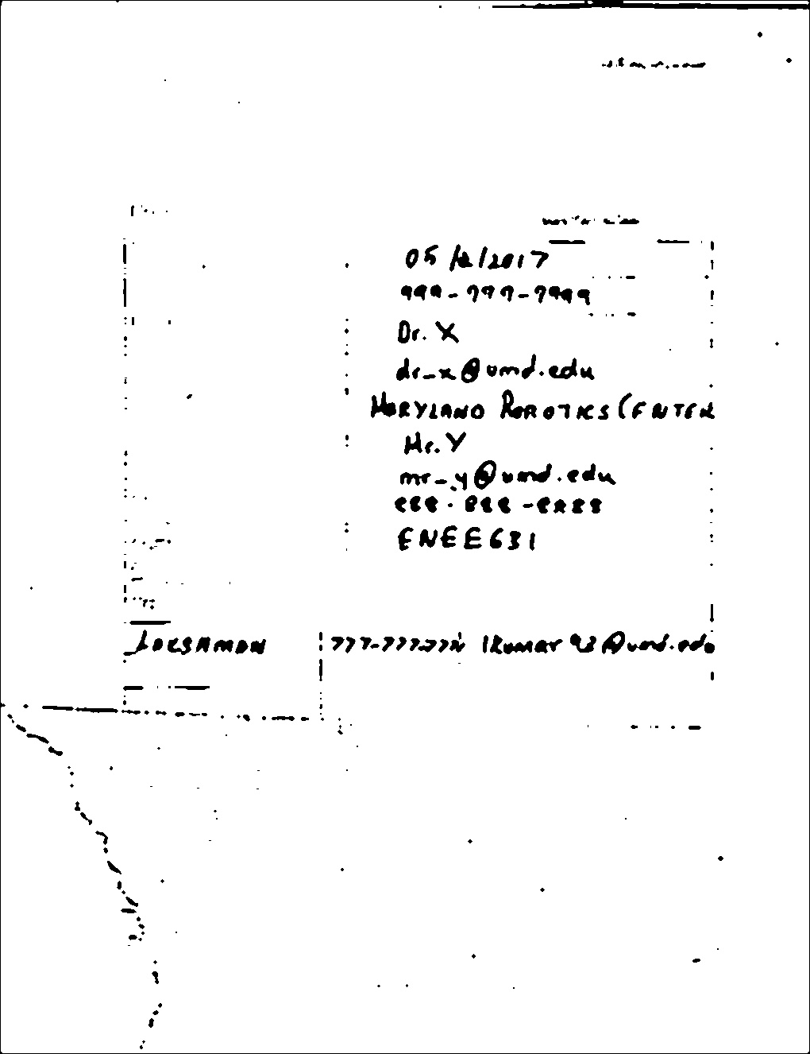
Background Subtraction
Extracted foreground

Slide 30
Foreground Addition
To overlay extracted content on the reference image
Based on the extracted foreground, pixels in the reference document are replaced by the pixels in the filled document
Noise in the restored image due to the additional residue in the extracted foreground

Slide 31
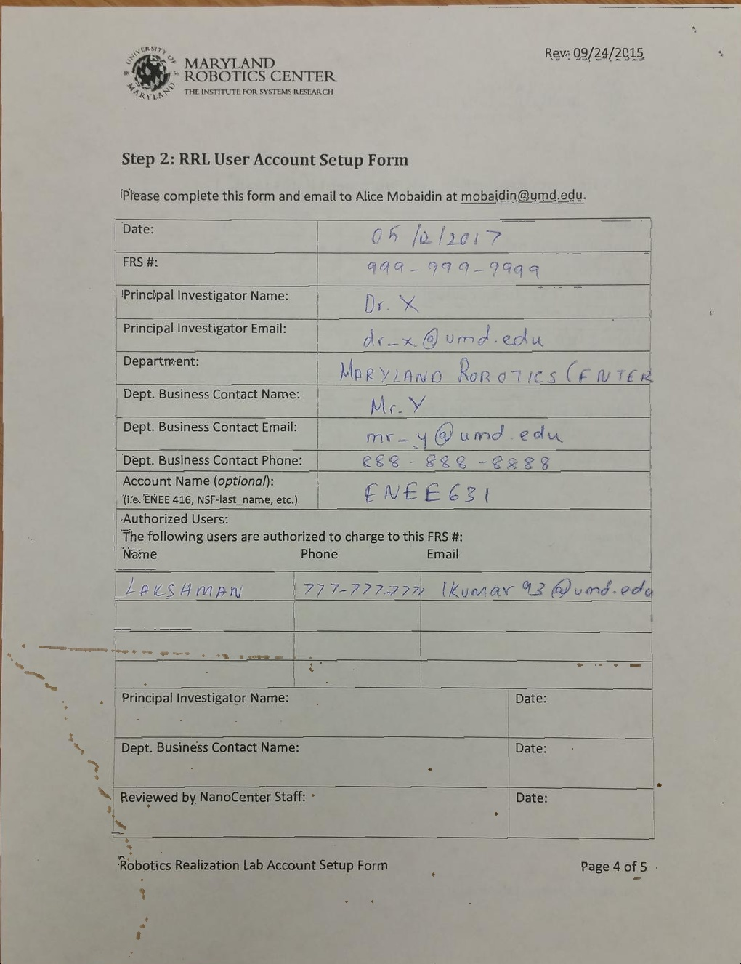
Foreground Addition

Slide 32
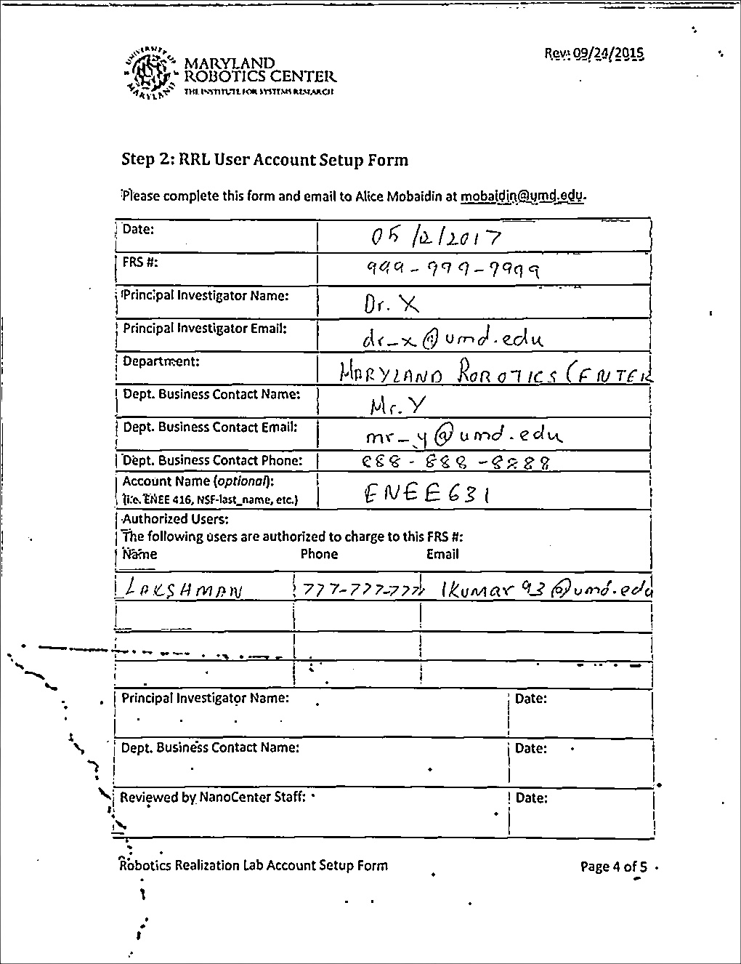
Foreground Addition

Slide 33
Conclusion
Based on the results of the project, a few keen observations can be made as follows.
The techniques work well as long as the assumptions made are satisfied.
Document extraction takes about 5 to 7 seconds and Image registration takes about 15 to 25 seconds depending on the size and nature of the image.
Sometimes image specific tuning is required for parameters like adaptive thresholding constant, kernel sizes.
As assumptions made do not require any sort of markings or specific ink color for the filled content, the output is not perfect.
Background subtraction works well in-spite of partial visibility of the filled document.

Slide 34
Conclusion
Future Works
Optimize the code and algorithm to take less then 2 seconds to give the final output.
Reduce the number of assumptions made.
Do additional filtering to remove artifacts due to border effects, obstructions and minute differences in image alignment.
Automated tuning of certain parameters based on the nature of the image.
Integrate OCR .

Slide 35
Source Code
Accessible through the link below
https://github.com/lkumar93/Image-Processing/blob/master/mobile_scanner

Slide 36
References
Gonzalez, Rafael C. and Richard E. Woods (2006). Digital Image Processing (3rd Edition).
Bradski, G. (2000). “The OpenCV Library”.
Fisher, Robert et al. (1997). Hypermedia Image Processing Reference (HIPR).
Jain, Anil K. (1989). Fundamentals of Digital Image Processing
Canny, J (1986). “A Computational Approach to Edge Detection”.
Suzuki, S. and K Abe (1985). “Topological Structural Analysis of Digitized Binary Images by Border Following”.
Ethan, Rublee et al. (2011). “ORB: An efficient alternative to SIFT or SURF”.
Fletcher, Lloyd A. and Rangachar Kasturi (1988). “A Robust Algorithm for Text String Separation from Mixed Text/Graphics “ .
Fischler, Martin A. and Robert C. Bolles (1981). “Random Sample Consensus: A Paradigm for Model Fitting with Applications to Image Analysis and Automated Cartography”.
Harris, Chris and Mike Stephens (1988). “A combined corner and edge detector”.

Slide 37
References
Mundy, Joseph L. and Andrew Zisserman (1992). “Geometric Invariance in Computer Vision”.
Tomasi, C. and R. Manduchi (1998). “Bilateral Filtering for Gray and Color Images”.
Altman, N. S. (1992). “An Introduction to Kernel and Nearest-Neighbor Nonparametric Regression”.
Lowe, David G. (2004). “Distinctive Image Features from Scale-Invariant Keypoints”.
Bay, Herbert et al. (2008). “Speeded-Up Robust Features (SURF)”.
Calonder, Michael et al. (2010). “BRIEF: Binary Robust Independent Elementary Features”.
Rosten, Edward and Tom Drummond (2005). “Fusing Points and Lines for High PerformanceTracking”.

Slide 38
QUESTIONS ?

